Slide 1
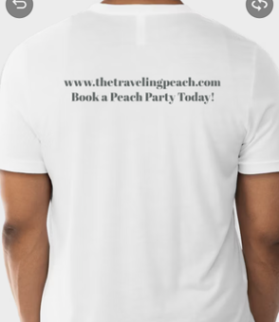
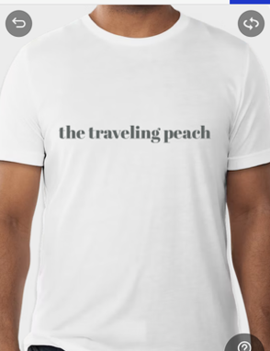
the traveling peach
This is going on ONE white Medium t-shirt and ONE white XL t-shirt
FRONT
BACK
www.thetravelingpeach.com
Book a Peach Party Today!

Slide 2
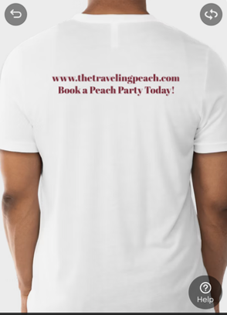
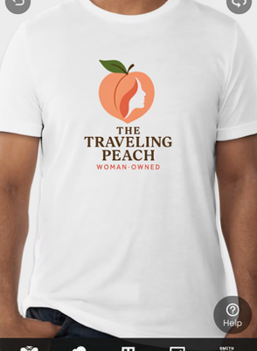

All other white t-SHIRTS
FRONT
BACK
www.thetravelingpeach.com
Book a Peach Party Today!

Slide 3

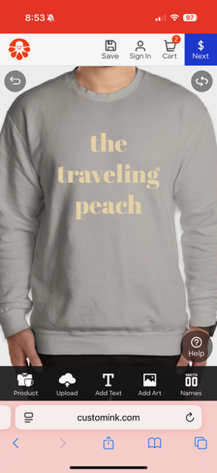
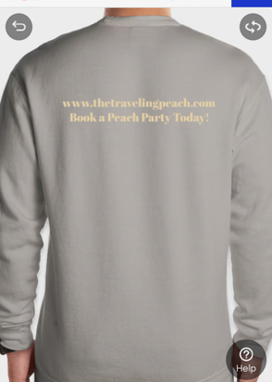


Grey sweatshirt
the
traveling
peach

Slide 4
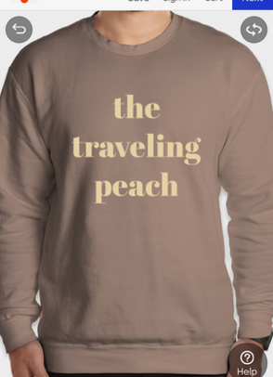
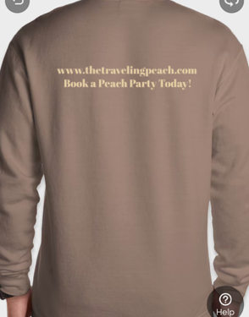
BROWN SWEATSHIRT
the
traveling
peach

Slide 5
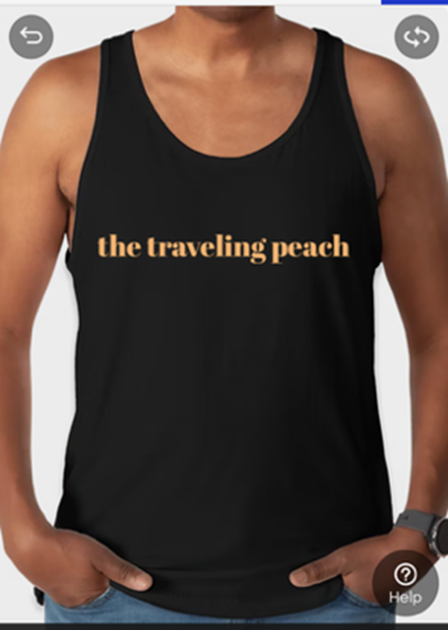
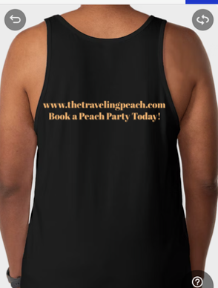
the traveling peach
BLACK TANK TOP
FRONT
BACK
www.thetravelingpeach.com
Book a Peach Party Today!

Slide 6
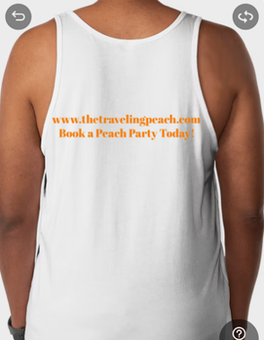
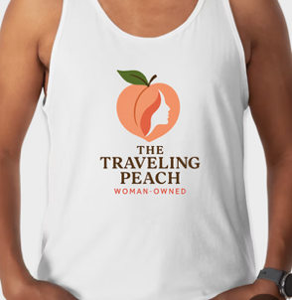
WHITE TANK TOP
FRONT
BACK
www.thetravelingpeach.com
Book a Peach Party Today!

